Slide 1



Design, Formulation and Standards Development for Mass-Food Fortification
Omar Dary
16-May-2009
BASF-A₂Z Special Workshop
Micronutrient Forum, Beijing, China

Slide 2
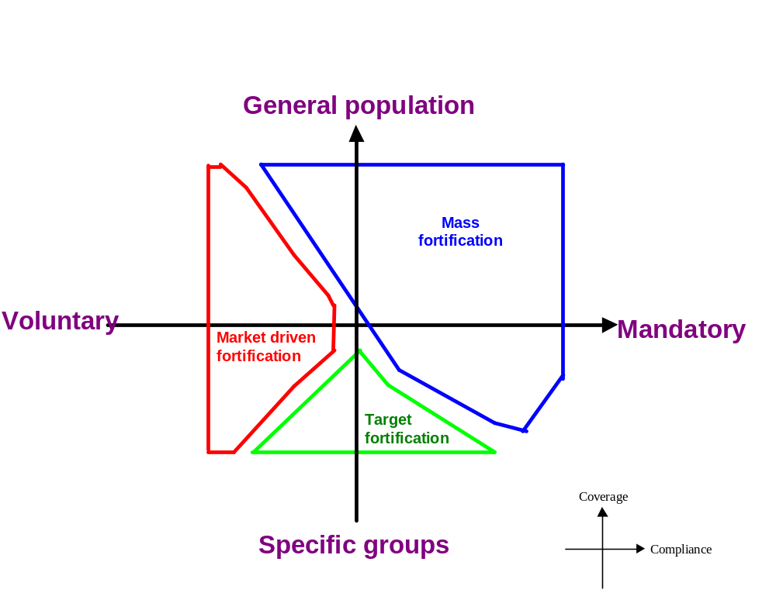
Types of food fortification

Slide 3
Food fortification
“Food fortification is the practice of deliberately increasing the content of essential micronutrients in a food so as to improve the nutritional quality of the food supply and to provide a public health benefit with minimal risk to health.”
WHO/FAO Guidelines on Food Fortification

Slide 4
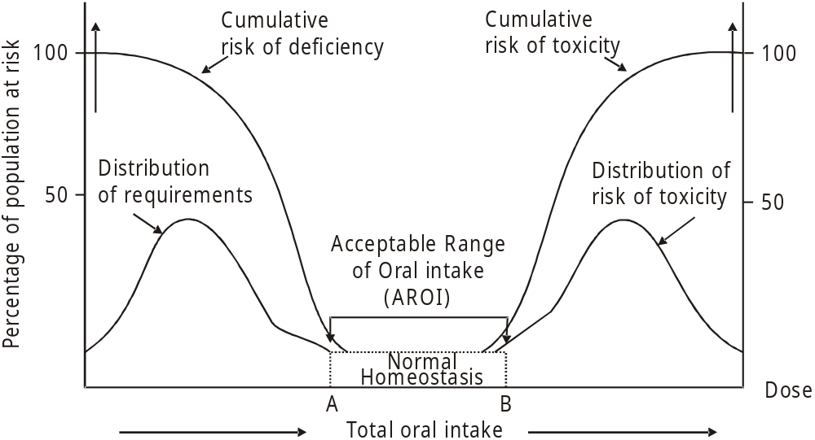
Keeping the equilibrium between need and safety
EAR
UF
LOAEL
RNI
UL
NOAEL
Modified from the International Programme on Chemical Safety (IPCS), 2002.

Slide 5
EAR: Estimated average requirement
Average requirement for healthy individuals in which functional/clinical assessment conducted and adequacy determined
Limited in number due to few human studies
Half of subjects’ needs met at this level; 50% of subjects would not have their needs met
Different for each age, gender and physiological group
201-02

Slide 6
RDA (RNI): Recommended Daily Allowance
Sufficient to meet the daily needs of most individuals in a specific life stage and gender group
Set at a level that is at the top 2 to 3 percent of the requirement distribution
Intended to serve as a goal for daily intake by individuals
203-02

Slide 7
Relationship of EAR and RDA
Estimated Average Requirement (EAR) = requirement for 50% of the population
Recommended Nutrient Intake (RNI) = requirement for 97.5% of the population
RNI = EAR + 2 SD
(if symmetrically distributed)
205-02

Slide 8
UL: Tolerable Upper Intake Level
The highest level of daily nutrient intake that is likely to pose no risks of adverse health effects to almost all individuals in the general population
  Not a recommended level of intake
  Not a level that is desirable to attain
  Not a level that is “toxic”
211-02

Slide 9
Special cases of EAR and UL*
Micronutrient | EAR | UL
β-Carotene** | 2.569 | -
Vit. A (Retinol) | 0.429 | 3.000
Niacinamide | 12.3 | -
Nicotinic acid | 12.3 | 35.0
Folate | 0.320 | -
Folic Acid | 0.188 | 1.000
* Applied to adult males (mg/day)
** If synthetic 0.858 mg/day

Slide 10
Dietary goals of the program
Diet + Interventions < UL for most individuals
Criteria of Safety
Diet + Interventions > EAR for most individuals
Criteria of Need
PROGRAM: ∑ fortified foods + supplements + others

Slide 11
Estimating micronutrient intake
    BIOEFFICACY → [ BIOAVAILABILITY & BIOCONVERSION ]
    x INTAKE
{
{
INTAKE= ∑ [Nutrient content] x amount consumed x frequency
Technology
Consumer Behavior

Slide 12
Determining the Technological Limit
Technological compatibility between the fortificant (source of micronutrient) and the food matrix: no changes in color, flavor, odor, and physical properties.
Fortificant does not segregate from the food matrix.
Dilution factor (final amount/fortificant amount) large enough to be added and mixed easily.

Slide 13
Intake profiles are asymmetric
Median
Mean
EAR
UL
Intakes
Frequency
Population with low intakes
Area estimates
proportion at risk of excess
Usual Intake (amount/day)
Modified from Suzanne Murphy
Population averages approach the mean of the “average” adult equivalent; ie adult women. It could also be assumed that those values are equivalent to the median of the adult males.

Slide 14
Estimating intakes of the food vehicles
Person-level data: 24 hr recall dietary intake surveys
Household-level data: Household Income and Expenditure Surveys (HIES)
Country-level data: Food Balance Sheets (FBS) and food industry data
Modified from Rafael Flores, IMPPaCt

Slide 15
Information from household surveys
Number of persons
  Age
  Sex
  Income quintile
  Rural-Urban residence
  Many countries’ data are at the sub-national level
Therefore it allows: Estimation of Consumption per “adult equivalent”
Grams purchased per household per day
Household Adult Equivalent Units
Modified from Rafael Flores, IMPPaCt

Slide 16
Concept of the “Adult Equivalent”
Age | Energy Requirement kcal/day | Adult Equivalent Units
4-6 yrs | 1,400 | 0.47
7-9 yrs | 1,760 | 0.59
19-50 yr-old male* | 3,000 | 1.00
19-50 yr-old female | 2,375 | 0.79
Total “Adult Equivalents” |  | 2.85
If household daily intake of oil was: 34 mL = 34/2.85 = 12 mL/day per “Adult Equivalent”
What is the estimated intake of a 7-9 yrs old child? 12 mL/day x 0.59 = 7 mL/day.

Slide 17
Limitations of household data
  Individual food intake is not measured directly
  No information about the distribution of intakes of the food vehicle within the household
  Does not guarantee that the vulnerable groups are consuming the foods
  Assumes that purchased food are fortified – could be an over estimation
Modified from Rafael Flores, IMPPaCt

Slide 18
Estimated oil and sugar intakes in Uganda
g/day per Adult Equivalent at different percentiles of intake
Food | P-5 | P-50 | P-95
Oil | 3 | 12 | 50
Sugar | 12 | 40 | 128
Both | 6 | 44 | 144
From Marc Smitz and Jack Fiedler. Ugandan Expenditure Survey - 2003

Slide 19
If only the food availability is known
  Per capita = Total availability (MT)/ population (millions)
  Apparent Intake = Per capita/% users
  P₅ = Apparent intake/(2 to 4)
  P₉₅ = Apparent intake x (2 to 4)
  For example: 100,000 MT of oil, for 25 million persons, and 60 % users.
  P₅₀ = (100,000 MT/(30 million x 0.6 x 365 days) = 15 g/day; P₅ = 4-8 g/day; P₉₅ = 30-60 g/day.

Slide 20
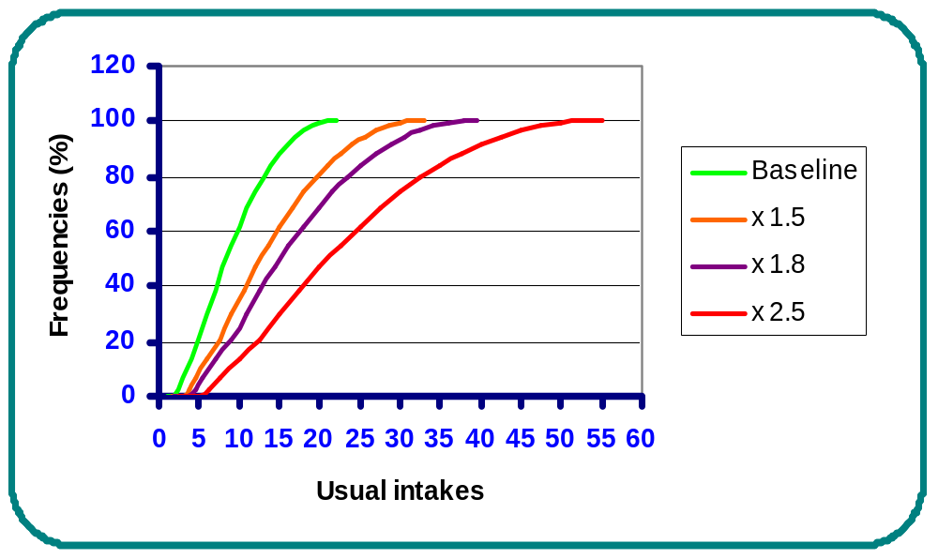
Determining the Safe Fortification Limit
EAR
UL
The safe limit, and the most cost-effective level, would be x 1.5; in the case of oil in Uganda, it was: 50 mg/kg; lower than the technological limit.

Slide 21
Defining the acceptable allowable cost
Absolute and relative costs of oil fortification in Uganda
[Vit. A] (mg/kg) | US$/MT | % Price* | Consumer cost US$/year
5 | 1.27 | 0.25 % | 0.006
10 | 2.55 | 0.51 % | 0.011
15 | 3.82 | 0.76 % | 0.017
20 | 5.10 | 1.02 % | 0.023
25 | 6.37 | 1.27 % | 0.029
35 | 8.92 | 1.78 % | 0.040
Assuming US$0.50/kg, and adjusted “average” consumption of 12 g/day.

Slide 22
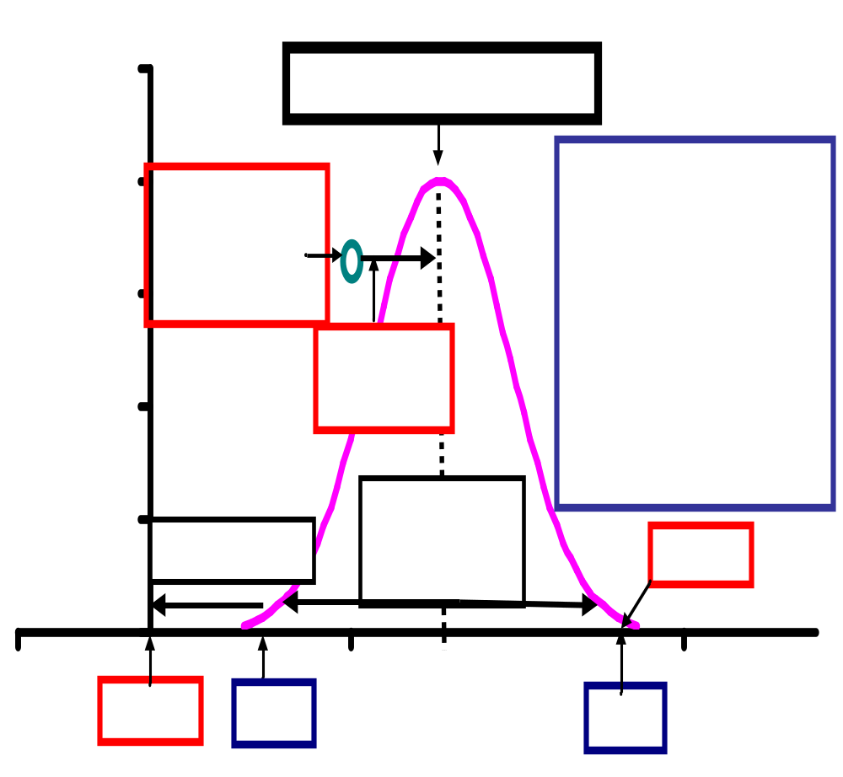
Establishing the food control parameters
Vitamin A content in fortified oil in Uganda
Average Level =
Selected FL+ Intrinsic content =
25 + 0 = 25 mg/kg
Minimum Level =
Average x (1 – 1.28CV process/100) = 25 x (1 – 1.28(15)/100) =
25 x 0.81 = 20 mg/kg
Maximum Level =
Average x (1 + 1.28CV process/100) = 25 x (1 + 1.28(15)/100) =
25 x 1.19 = 30 mg/kg
Legal Minimum Level =
Minimum Level x (1-proportion losses) =
20 x (1-0.25) = 15 mg/kg
P-10
P-90

Slide 23
Defining levels for the standards
  At factory: the average content should be 25 mg/kg of vit. A, and the acceptable analytical range should be 20 to 30 mg/kg.
  At retail: The minimum reduces to 15 mg/kg.
  For labeling: the claimed amount should be 22 mg/kg (15 + 30 = 45/2 = 22).
  For inspection of factories: it is expected an average content around 25 mg/kg, with 80% of samples within the analytical range of 20 to 30 mg/kg. However, all samples should contain vitamin A.

Slide 24
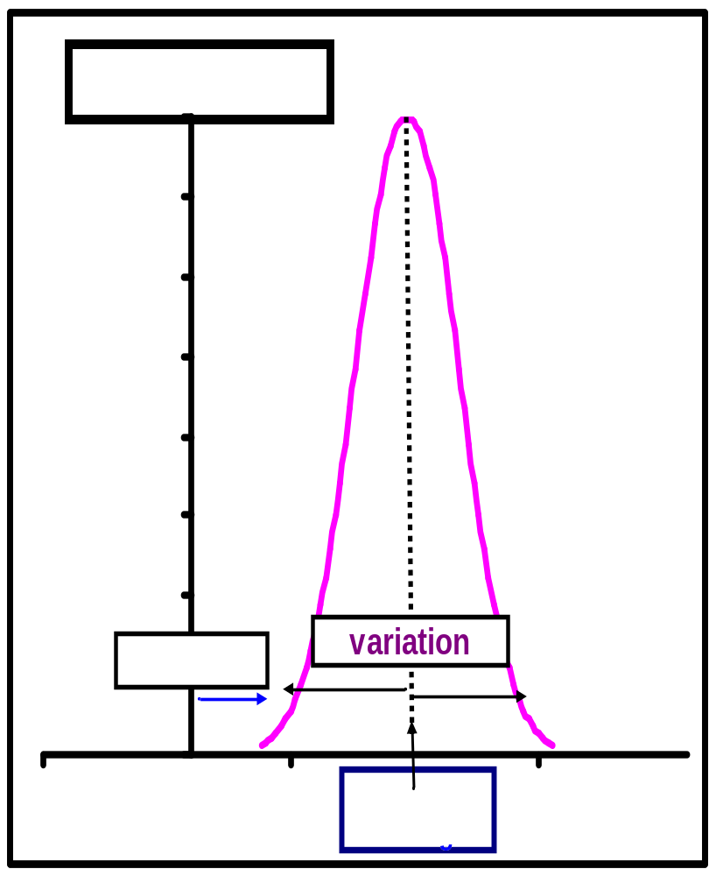
Formulating the premix
Average (Target) Level x Dilution Factor =
25 mg/kg x 1000 = 25 g/kg
Minimum content = 25 g/kg x 0.9* = 22.5 g/kg
Maximum content = 25 g/kg x 1.2** = 30 g/kg
* Equiv. 5% variation; ** larger because overage.
Cost: [Fortificant] at average&overage + Transportation + Taxes
In the case of premixes, they may have an additional amount for compensating for losses, i.e. the overage.

